Slide 1
Digital Portfolio
STUDENT NAME: Akash R
REGISTER NO AND NMID : 24131150500121006 & autanm115anm115213006
DEPARTMENT : BCA (Bachelor of Computer Applications)
COLLEGE : MRK COLLEGE OF ARTS AND SCIENCE

Slide 2
PROJECT TITLE
PORTFOLIO

Slide 3


AGENDA
Problem Statement
Project Overview
End Users
Tools and Technologies
Portfolio design and Layout
Features and Functionality
Results and Screenshots
Conclusion
Github Link
3/21/2024 Annual Review

Slide 4

PROBLEM STATEMENT
In the current digital era, students and professionals need a single, organized place to showcase their skills, education, and projects. Traditional resumes are static and lack interactivity, making it difficult for recruiters to quickly evaluate a candidate’s potential.

Slide 5

PROJECT OVERVIEW
The Akash Portfolio is a personal web-based digital profile designed to highlight academic achievements, technical skills, and project work. It allows recruiters and collaborators to quickly view all professional details in a clean, responsive format.
The portfolio serves as an online resume + project gallery, increasing visibility and improving professional networking opportunities.

Slide 6

WHO ARE THE END USERS?
Students: To showcase their skills and projects for internships.
Recruiters / HR: To evaluate candidates’ technical skills and project experience.
Peers & Mentors: To collaborate or review projects.
Personal Branding: Anyone looking to maintain a professional online presence.

Slide 7

TOOLS AND TECHNIQUES
Frontend: HTML, CSS, JavaScript
Version Control: Git & GitHub
Hosting: GitHub Pages
ENVIRONMENTS: Vs studio.

Slide 8
POTFOLIO DESIGN AND LAYOUT
Home Page: Introduction & short bio with profile photo
About Section: Academic details, certifications, and skills
Projects Section: Individual project cards with descriptions & links
Contact Section: Email, LinkedIn, GitHub links, and contact form
Responsive Design: Works on mobile, tablet, and desktop screens
8

Slide 9
FEATURES AND FUNCTIONALITY
WEB LINK: https://tgakash03.github.io/Portfolio/
GITHUB LINK:GIT LINK: https://github.com/tgakash03
Clean and responsive UI design
Organized sections for easy navigation
Social media and professional profile links
Contact form for direct communication
Easy to update as new projects/skills are added

Slide 10
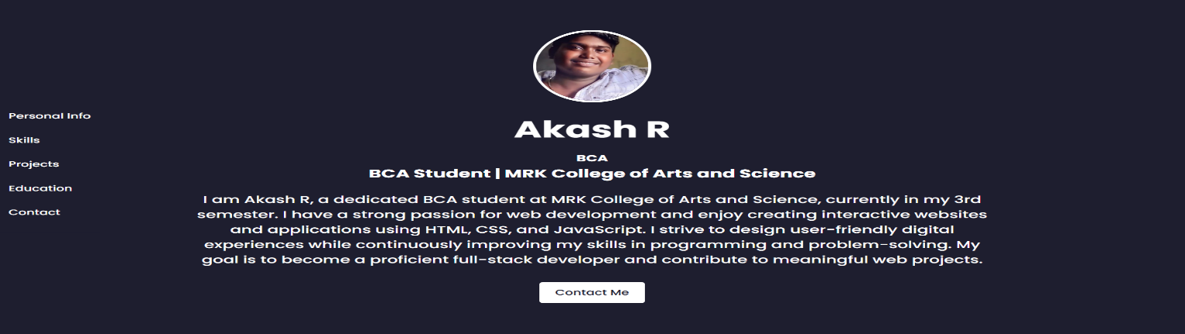
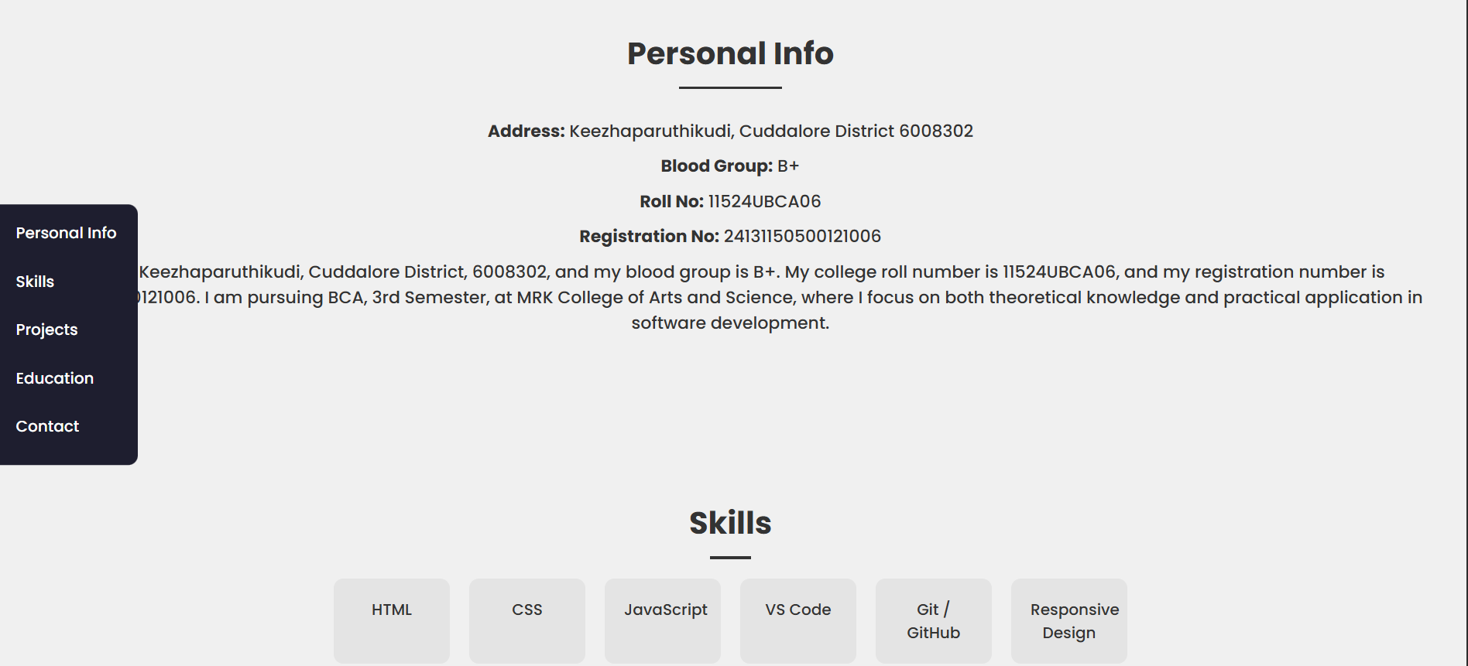

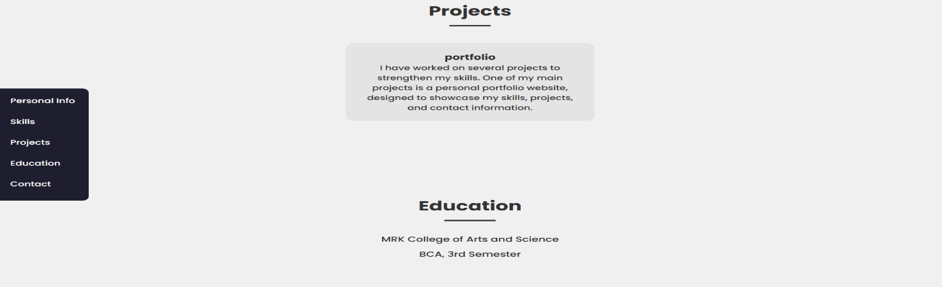
RESULTS AND SCREENSHOTS
3/21/2024 Annual Review
10

Slide 11
CONCLUSION
This portfolio project helped me improve my HTML, CSS, JavaScript skills, learn about responsive design, and understand the importance of version control using Git & GitHub. It acts as a professional online profile and can be easily shared with recruiters, increasing my chances of landing internships and jobs.
11

